Slide 1
IEEE TNSM 2020
Reliable Slicing of 5G Transport Networks With Bandwidth Squeezing and Multi-Path Provisioning
Slicing with dedicated protection.
To reduce backup resources:
bandwidth squeezing
survivable multi-path provisioning.
Multi-path provisioning can guarantee up to 40% of the bandwidth requested by a VN during failures by provisioning only 10% of additional spectrum resources.
Notes:
Bandwidth squeezing is motivated by the fact that not all services require the full bandwidth to be operational

Slide 2
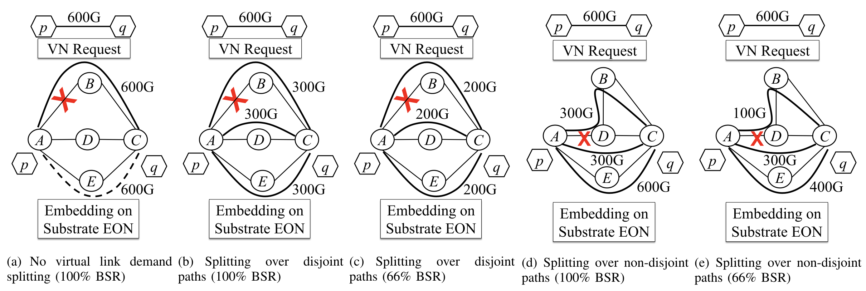
Reliable Slicing of 5G Transport Networks With Bandwidth Squeezing and Multi-Path Provisioning
Extent of bandwidth reduction = bandwidth squeezing rate (BSR) = %original bandwidth available after failure

Slide 3

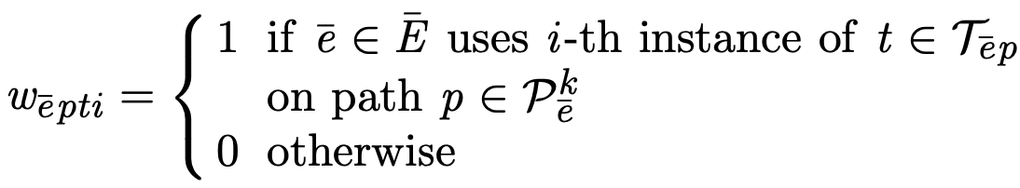
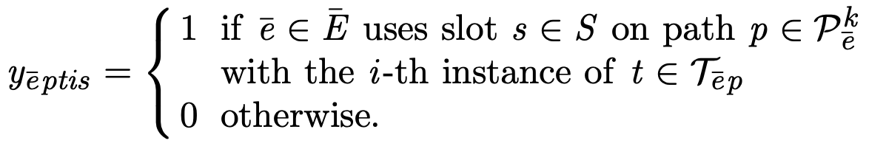
Reliable Slicing of 5G Transport Networks With Bandwidth Squeezing and Multi-Path Provisioning
Mathematical Model
undirected graph G = (V, E)
Transmission Config –
reach table R – max length of paths.
No.of Slots - n_{t}
Decision Variables -
Notes:
D - different data-rates
B - baud-rate or symbol-rate
M – modulation format
F - FEC overhead
Decision Variables
1. variable represents VLink mapping:
2. creates the relationship between a mapped SPath and the slots in its SLinks

Slide 4
Reliable Slicing of 5G Transport Networks With Bandwidth Squeezing and Multi-Path Provisioning
Problem Formulation
Constraints –
VLink Demand Constraints
VLink split across multiple (up to q) Spaths
Sum of data-rates > VLink’s demand
Slot Assignment and Spectral Contiguity Constraints
Given transmission config, n_{t} to meet data rate
spectrum contiguity constraint
Reliability Constraints
Data rate ≥ BSR% of original demand
Objective Function
cost function minimizes the total number of spectrum slots required

Slide 5
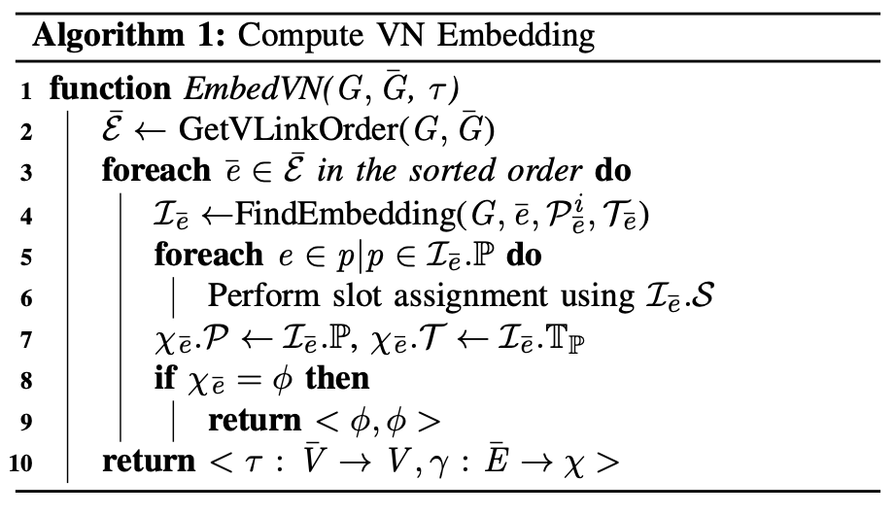
Reliable Slicing of 5G Transport Networks With Bandwidth Squeezing and Multi-Path Provisioning
Heuristic Algorithm
Notes:
A l g . 1 t a k e s a s i n p u t a V N G ̄ , a n E O N G , a n d a n o d e
mapping function τ : V ̄ → V . One way of computing a cost efficient VLink mapping for a given VNode mapping is to consider all |E ̄|! possible orders for sequentially embedding VLinks. The lowest cost mapping among all possible VLink orders then can be chosen as a cost effective solution for the given VNode mapping. However, this brute-force approach is not scalable. Instead, Alg. 1 considers only one sequen- tial VLink order that is computed to converge to a solution within a reasonable time.

Slide 6
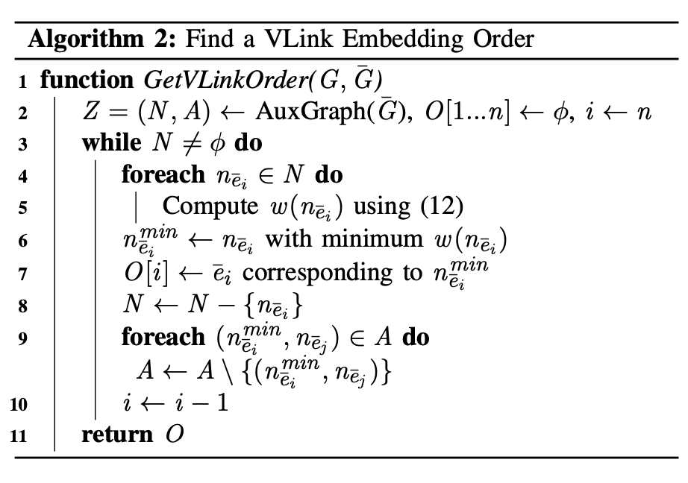
Reliable Slicing of 5G Transport Networks With Bandwidth Squeezing and Multi-Path Provisioning
Heuristic Algorithm
Notes:
To increase the chances of finding a feasible VN embedding, Alg. 1 invokes Alg. 2 that finds a good order of the VLinks (E ̄) to embed. For each VLink
Alg. 2 finds an order of VLinks, O, that increases the
chances of finding a feasible embedding for all the VLinks.
Computing a feasible embedding of a VLink depends on the
availability of contiguous slots in the candidate SPaths of that
VLink. If the candidate SPaths Pk of a VLink e ̄ have many e ̄i i
SLinks that are common with the candidate SPaths of other
VLinks that appear before e ̄i in a VLink order o, the slots of
these SLinks (correspondingly, SPaths) may be exhausted or
fragmented in such a way that the embedding of e ̄i becomes
infeasible. Note that VLinks that come after e ̄i in o do not

Slide 7
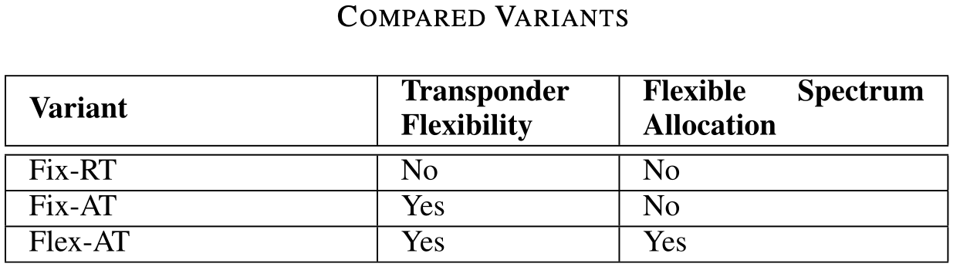
Reliable Slicing of 5G Transport Networks With Bandwidth Squeezing and Multi-Path Provisioning
Evaluation –
Fix-RT: Fixed-grid spectrum allocation with one tuple for modulation format, FEC overhead
Fix-AT: choose from a variety of modulation formats and/or FEC overheads for spectrum slot allocation granularity of 50GHz.
Flex-AT: choose from a variety of modulation formats and/or FEC overheads for spectrum slot allocation granularity of 12.5GHz.

Slide 8
Reliable Slicing of 5G Transport Networks With Bandwidth Squeezing and Multi-Path Provisioning
Evaluation –
Performance Metrics
Spectrum slot Usage (SSU)
Protection overhead
Max. no. of disjoint paths
Max. no. of splits
Cost ratio
Execution time
Blocking ratio
Link utilization
Notes:
a) Spectrum slot Usage (SSU): The total number of spectrum slots required to embed a VN.
b) Protection overhead: Ratio between total bandwidth allocated of a VLink (on all different splits) and the actual bandwidth demand of the VLink. It is a measure of the required extra bandwidth for providing protection.
c) Max. no. of disjoint paths: Average of the maximum number of disjoint SPaths used to embed a VLink.
d) Max. no. of splits: Average of the maximum number of splits used to embed a VLink.
e) Cost ratio: The ratio of costs obtained by two different approaches for solving the same problem instance.
f) Execution time: The time required for an algorithm to find a VN embedding.
g) Blocking ratio: The fraction of VN requests that could not be embedded on the EON over all the VN requests in a simulation.
h) Link utilization: The ratio between the number of slots used in an SLink and the total number of slots in the SLink at any instance of time.

Slide 9
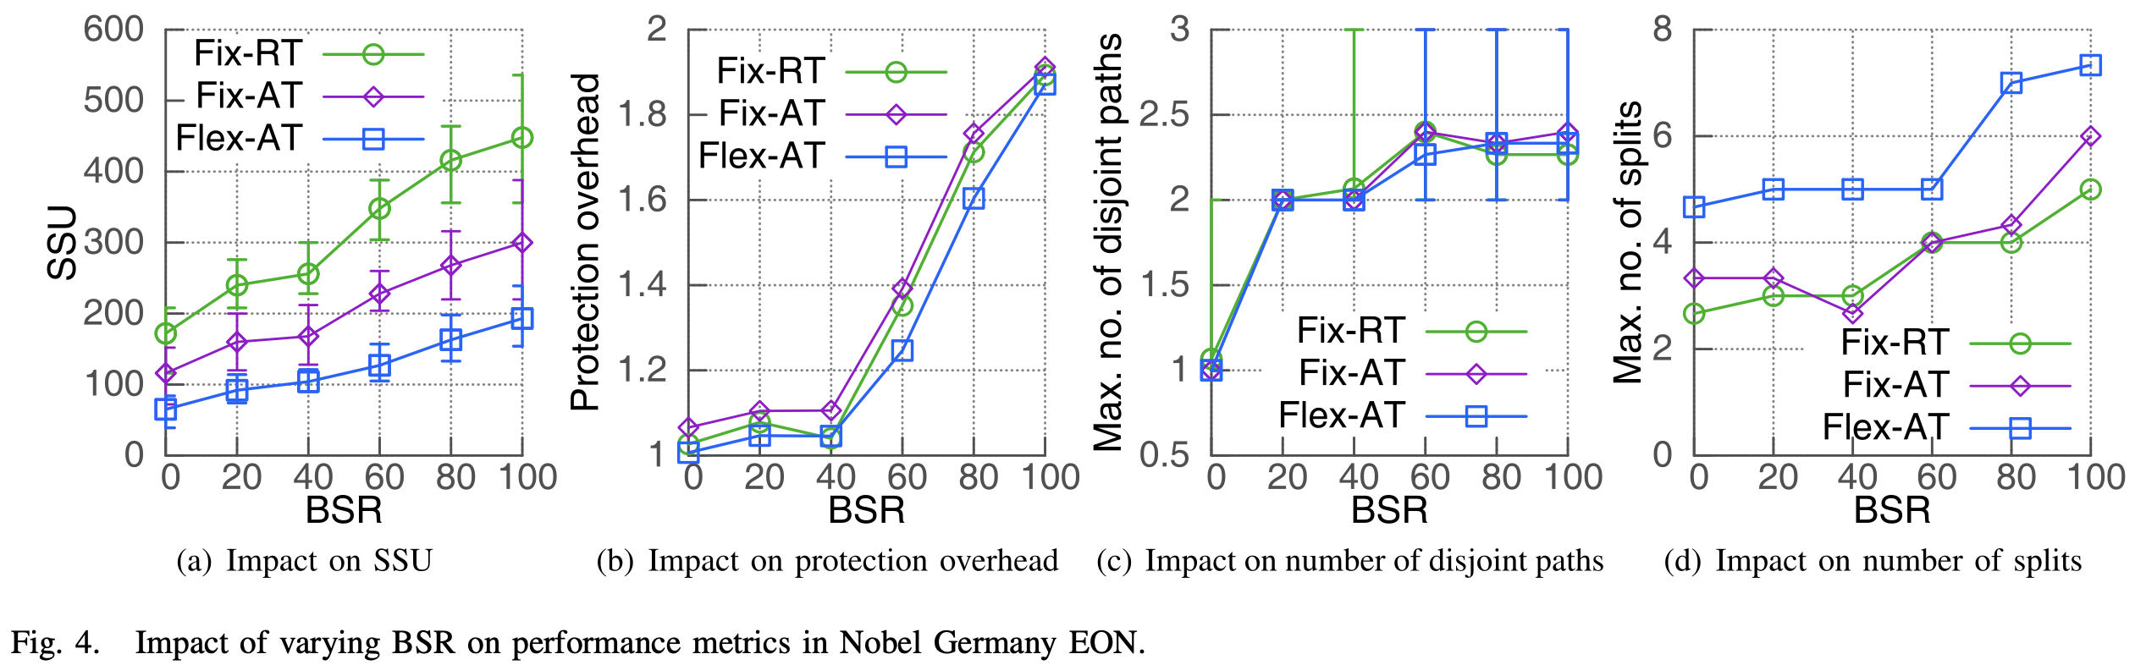
Reliable Slicing of 5G Transport Networks With Bandwidth Squeezing and Multi-Path Provisioning
Results
Small-Scale Results With ILP Formulation

Slide 10
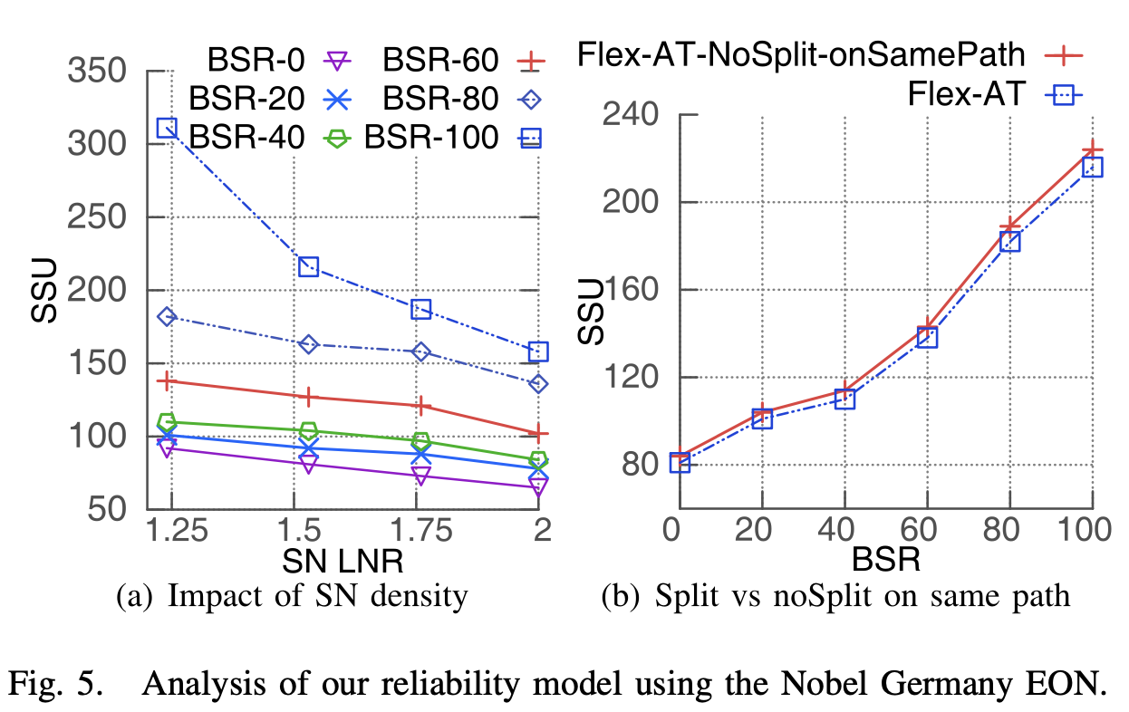
Reliable Slicing of 5G Transport Networks With Bandwidth Squeezing and Multi-Path Provisioning
Results
SN connectivity impact on spectral efficiency

Slide 11
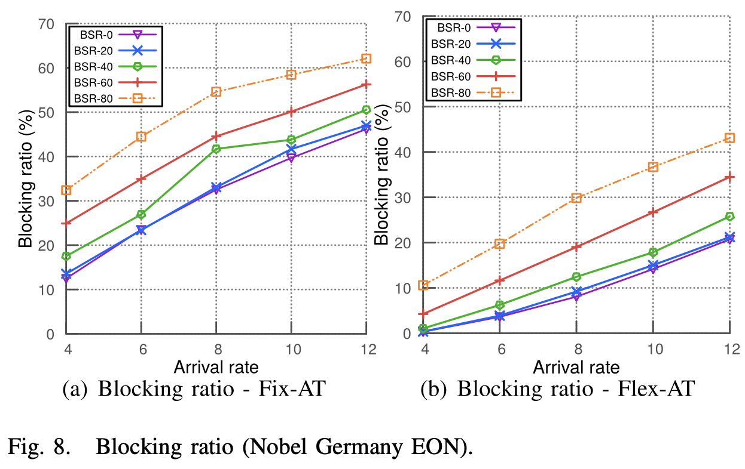
Reliable Slicing of 5G Transport Networks With Bandwidth Squeezing and Multi-Path Provisioning
Results
Blocking Ratio

Slide 12
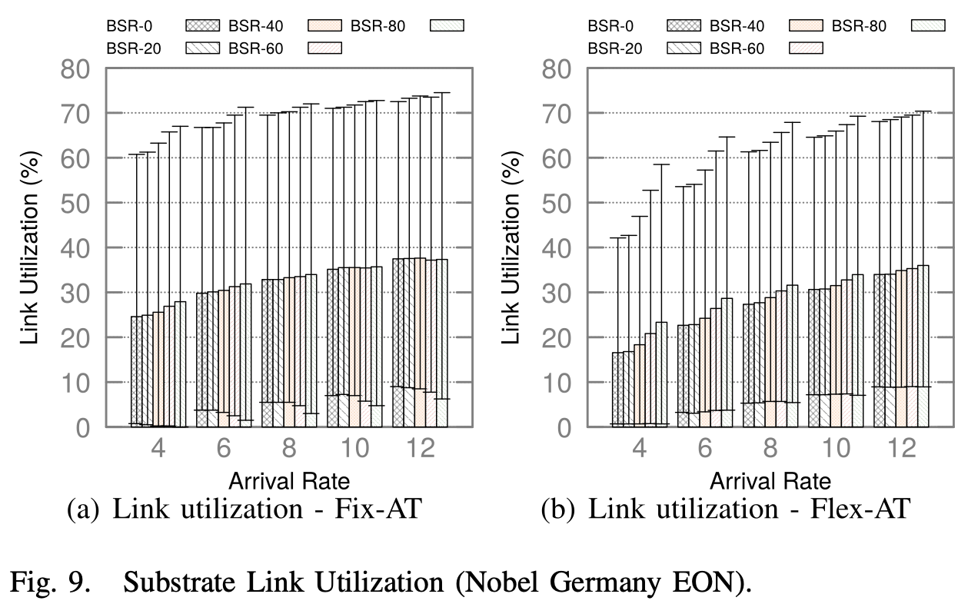
Reliable Slicing of 5G Transport Networks With Bandwidth Squeezing and Multi-Path Provisioning
Results
Substrate Link Utilization

